Slide 1






EF Core: Advanced Relations and Aggregation
Working with Fluent API,
Querying Data
Advanced
Relations
SoftUni Team
Technical Trainers
Software University
http://softuni.bg

Slide 2


Table of Contents
Fluent API
Grouping and Joining Tables
View Models
Attributes

Slide 3
Questions
sli.do #CSharpDB

Slide 4

Fluent API
Advanced ModelBuilder Methods

Slide 5
Fluent API: Renaming DB Objects
Optional schema name
Specifying Custom Table name
Custom Column name/DB Type
modelBuilder.Entity<Order>().ToTable("OrderRef", "Admin");
modelBuilder.Entity<Student>()
.Property(s => s.Name)
.HasColumnName("StudentName")
.HasColumnType("varchar");

Slide 6
Fluent API: Column Attributes
Explicitly set Primary Key
Other column attributes
modelBuilder.Entity<Student>().HasKey("StudentKey");
modelBuilder.Entity<Person>()
.Property(p => p.FirstName)
.IsRequired()
.HasMaxLength(50)
modelBuilder.Entity<Post>()
.Property(p => p.LastUpdated)
.ValueGeneratedOnAddOrUpdate()

Slide 7
Fluent API: Miscellaneous Config
Do not include property in DB (e.g. business logic properties)
Disabling cascade delete
If a FK property is non-nullable, cascade delete is on by default
modelBuilder.Entity<Department>().Ignore(d => d.Budget);
modelBuilder.Entity<Course>()
.HasRequired(t => t.Department)
.WithMany(t => t.Courses)
.HasForeignKey(d => d.DepartmentID)
.OnDelete(DeleteBehavior.Restrict);
Throws exception on delete

Slide 8
Specialized Configuration Classes
Mappings can be placed in entity-specific classes
Include in OnModelCreating:
public class StudentConfiguration
: IEntityTypeConfiguration<Student>
{
public void Configure(EntityTypeBuilder<Customer> builder)
{
builder.HasKey(c => c.StudentKey);
}
}
Specify target model
builder.ApplyConfiguration(new CustomerConfiguration());

Slide 9

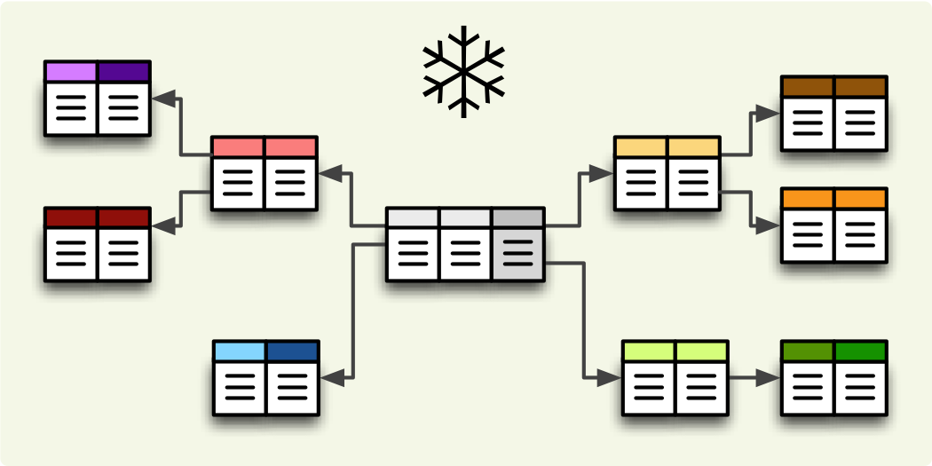
Filtering and Aggregating Tables
Select, Join and Group Data Using LINQ

Slide 10
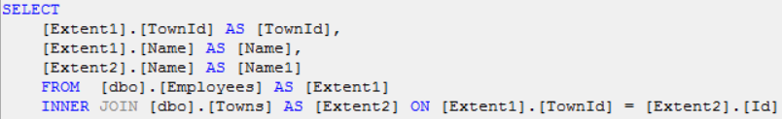
Good Reasons to Use Select
Limit network traffic by reducing the queried columns
Syntax:
var employeesWithTown = context
.Employees
.Select(employee => new
{
EmployeeName = employee.FirstName,
TownName = employee.Town.Name
});

Slide 11
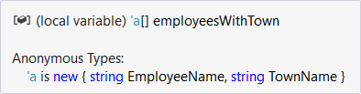
Good Reasons not to Use Select
Data that is selected is not of the initial entity type
Anonymous type, generated at runtime
Data cannot be modified (updated, deleted)
Entity is of a different type
Not associated with the context anymore

Slide 12
Joining Tables in EF: Using Include()
Joining tables:
Nested Joins:
ThenInclude can be called several times
var employees = softUniContext.Employees
.Include(e => e.Departments)
.ToList();
var posts = forumContext.Posts
.Include(e => e.Replies)
.ThenInclude(r => r.Author)
.ToList();

Slide 13
Joining Tables in EF: Using Join()
Join tables in EF with LINQ / extension methods on IEnumerable<T> (like when joining collections)
var employees =
softUniEntities.Employees.Join(
softUniEntities.Departments,
(e => e.DepartmentID),
(d => d.DepartmentID),
(e, d) => new {
Employee = e.FirstName,
JobTitle = e.JobTitle,
Department = d.Name
}
);

Slide 14
Grouping Tables in EF
Grouping also can be done by LINQ
The same way as with collections in LINQ
Grouping with LINQ:
Grouping with extension methods:
var groupedEmployees =
from employee in softUniEntities.Employees
group employee by employee.JobTitle;
var groupedCustomers = softUniEntities.Employees
.GroupBy(employee => employee.JobTitle);

Slide 15
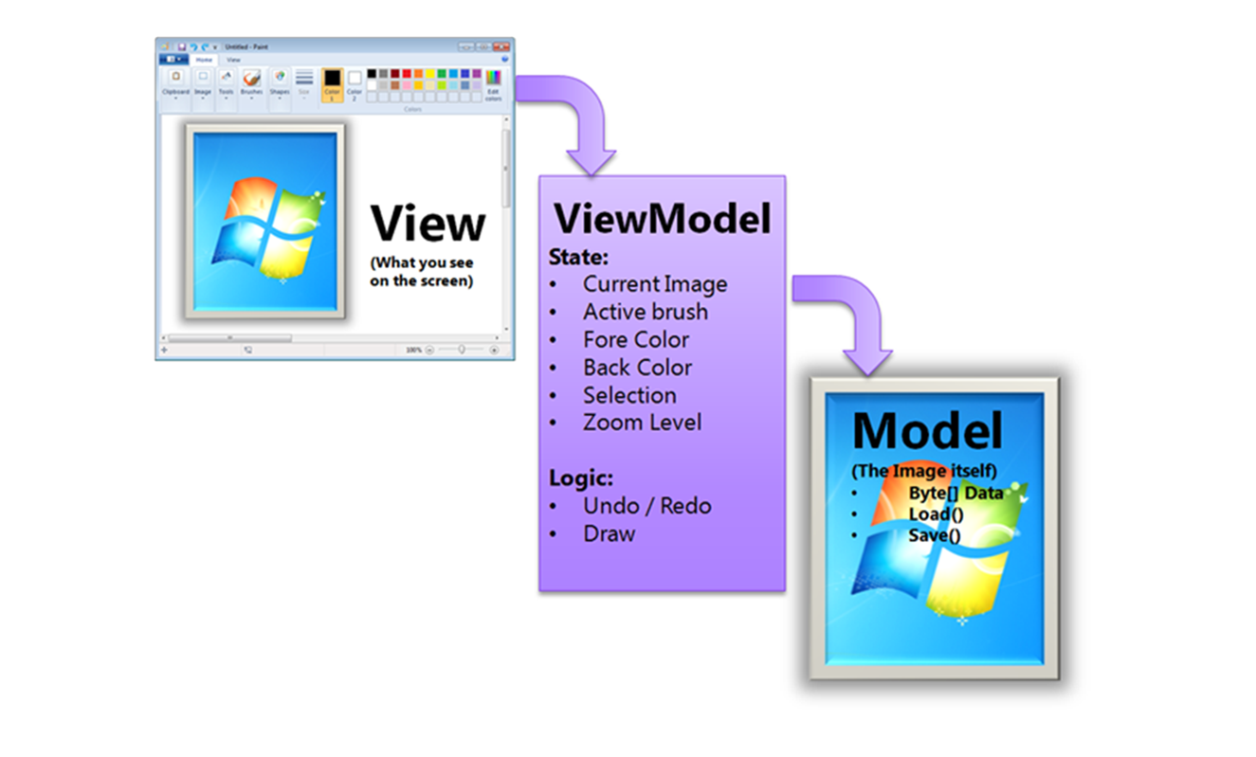
View Models
Simplifying Models

Slide 16
View Models
Select(), GroupBy() can work with custom classes
Allows you to pass them to methods and use them as return type
Requires some extra code (class definition)
Sample View Model:
public class UserViewModel
{
public string Alias { get; set; }
public byte[] Avatar { get; set; }
}

Slide 17
View Models (2)
Assign the fields as you would with an anonymous object:
The new type can be used in a method signature:
var currentUser = context.Users
.Find(8)
.Select(u => new UserViewModel
{
Alias = u.FirstName + " " + u.LastName,
Avatar = u.Avatar
})
.SingleOrDefault();
public static UserViewModel GetUserInfo(int Id) { … }

Slide 18
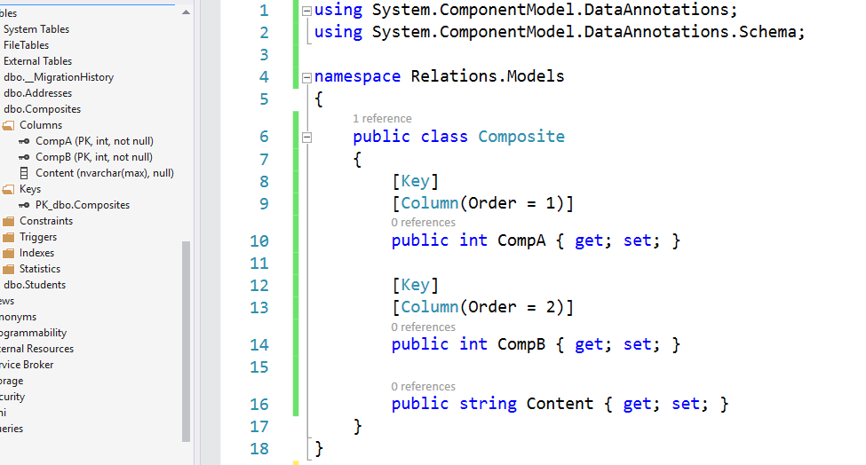

Attributes
Custom Entity Framework Behavior

Slide 19
Attributes
EF Code First provides a set of DataAnnotation attributes
You can override default Entity Framework behavior
To access nullability and size of fields:
To access schema customizations:
For a full set of configuration options you need the Fluent API
using System.ComponentModel.DataAnnotations;
using System.ComponentModel.DataAnnotations.Schema;

Slide 20
Key Attributes
[Key] – explicitly specify primary key
When your PK column doesn’t have an "Id" suffix
Composite key is only defined using Fluent API for now
[Key]
public int StudentKey { get; set; }

Slide 21
Key Attributes (2)
ForeignKey – explicitly link navigation property and foreign key property within the same class
Works in either direction (FK to navigation property or navigation property to FK)
public class Client
{
…
[ForeignKey("Order")]
public int OrderRefId { get; set; }
public Order Order { get; set; }
}

Slide 22
Renaming Objects
Table – manually specify the name of the table in the DB
[Table("StudentMaster")]
public class Student
{
…
}
[Table("StudentMaster", Schema = "Admin")]
public class Student
{
…
}

Slide 23
Renaming Objects (2)
Column – manually specify the name of the column in the DB
You can also specify order and explicit data type
public class Student
{
…
[Column("StudentName", Order = 2, TypeName="varchar(50)")]
public string Name { get; set; }
}
Optional parameters

Slide 24
Entity Validation
Required – mark a nullable property as NOT NULL in the DB
Will throw exception if not set to a value
Non-nullable types (e.g. int) will not throw an exception (will be set to language-specific default value)
MinLength – specify min length of a string (client validation)
MaxLength / StringLength – specify max length of a string (both client and DB validation)
Range – set lower and/or upper limits of numeric property (client validation)

Slide 25
Other Attributes
Index – create index for column
Primary key will always have an index
NotMapped – property will not be mapped to a column
For business logic properties
Optional name
Optional unique specifier
[Index("INDEX_REGNUM", IsUnique=true)]
public int RegistrationNumber { get; set; }

Slide 26
Summary
The Fluent API gives us full control over Entity Framework object mappings
Information overhead can be limited by selecting only the needed properties
ViewModels can be used to move aggregated data between methods
Attributes can be used to express special table relationships and to customize entity behaviour

Slide 27







EF Core: Advanced Relations and Aggregation
https://softuni.bg/courses/databases-basics-ms-sql-server

Slide 28






SoftUni Diamond Partners

Slide 29






SoftUni Diamond Partners

Slide 30
License
This course (slides, examples, demos, videos, homework, etc.) is licensed under the "Creative Commons Attribution-NonCommercial-ShareAlike 4.0 International" license
Attribution: this work may contain portions from
"Databases" course by Telerik Academy under CC-BY-NC-SA license

Slide 31





Trainings @ Software University (SoftUni)
Software University – High-Quality Education, Profession and Job for Software Developers
softuni.bg
Software University Foundation
http://softuni.foundation/
Software University @ Facebook
facebook.com/SoftwareUniversity
Software University Forums
forum.softuni.bg

